Slide 1
HTML and CSS
Lists

Slide 2
Types of lists
Definition list:
dl
Ordered list:
ol
Unordered list:
ul

Slide 3
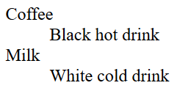
Definition list
<dl>
<dt>term1</dt>
<dd>description1</dd>
<dt>term2</dt>
<dd>description2</dd>
</dl>

Slide 4




Ordered list
<ol>
<li>item 1</li>
<li>item 2</li>
</ol>

Slide 5

Unordered list
<ul>
<li>item 1</li>
<li>item 2</li>
</ul>

Slide 6
CSS for lists
property | value
list-style-type (<ul>) | none
 | disc, circle, square
list-style-type (<ol>) | decimal
 | decimal-leading-zero
 | lower-roman
 | upper-roman
 | lower-alpha
 | lower-greek
 | lower-latin
 | upper-latin
list-style-image | url(‘filename.gif’)
list-style-position | outside
 | inside

Slide 7


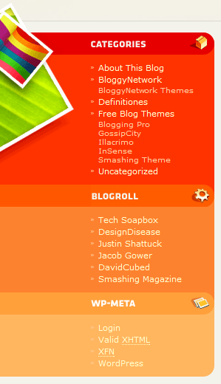



source: vandelaydesign.com + smashingmagazine.com
List examples

Slide 8
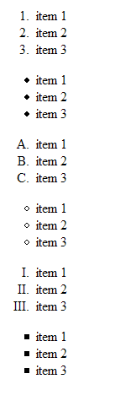
exercise 1
<ol>
<li>item 1</li>
<li>item 2</li>
</ol>
Kenmerk | waarde
list-style-type (<ul>) | none
 | disc, circle, square
list-style-type (<ol>) | decimal
 | decimal-leading-zero
 | lower-roman
 | upper-roman
 | lower-alpha
 | lower-greek
 | lower-latin
 | upper-latin
<ul>
<li>item 1</li>
<li>item 2</li>
</ul>
solution

Slide 9
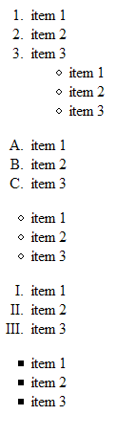
exercise 2
Nested lists!
Validate code!!!
solution

Slide 10
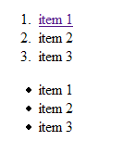
exercise 3
Item 1 is a link
Validate code!!!
solution

